Slide 1
Capstone Project
Ajay Pradeep M
NYC Taxi Trip Time Prediction Analysis

Slide 2
Data Summary
Dataset | NYC Taxi Data.csv
Data Description | The dataset is based on the 2016 NYC Yellow Cab trip record data made available in Big Query on Google Cloud Platform. The data was originally published by the NYC Taxi and Limousine Commission (TLC). The data was sampled and cleaned for the purposes of this project.
Problem Description | The task is to build a model that predicts the total ride duration of taxi trips in New York City. Your primary dataset is one released by the NYC Taxi and Limousine Commission, which includes pickup time, geo-coordinates, number of passengers, and several other variables.
Shape | 1458644 rows and 11 columns

Slide 3
Data Fields:
id - a unique identifier for each trip
vendor_id - a code indicating the provider associated with the trip record
pickup_datetime - date and time when the meter was engaged
dropoff_datetime - date and time when the meter was disengaged
passenger_count - the number of passengers in the vehicle (driver entered value)
pickup_longitude - the longitude where the meter was engaged
pickup_latitude - the latitude where the meter was engaged
dropoff_longitude - the longitude where the meter was disengaged
dropoff_latitude - the latitude where the meter was disengaged
store_and_fwd_flag - This flag indicates whether the trip record was held in vehicle memory before sending to the vendor because the vehicle did not have a connection to the server - Y=store and forward; N=not a store and forward trip
trip_duration - Duration of the trip in seconds. This is also our target variable.

Slide 4

Data Preprocessing :
Checking for null values and removing them.
Converting data types.
Checking whether column renaming is required.
Creating new columns if required.
One hot encoding.
Train Test Split

Slide 5
Univariate Analysis

Slide 6
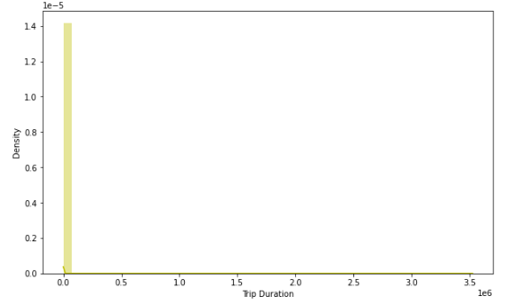
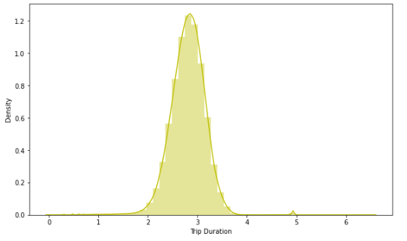
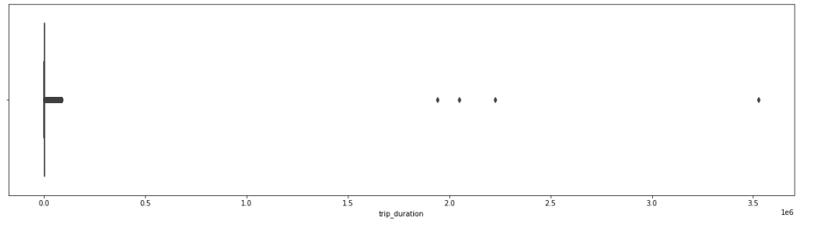
Dependent Variable - Trip Duration

Slide 7
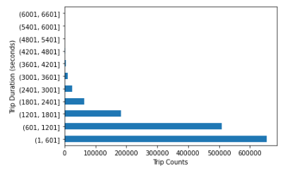
Trip counts grouped in terms of 600 seconds

Slide 8
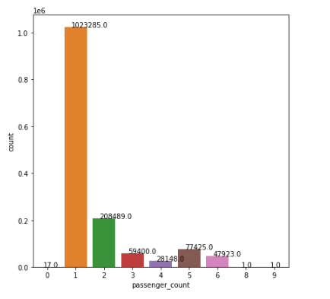
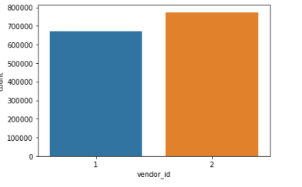
Vendor id and passenger count plot

Slide 9
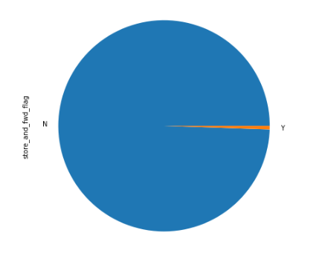
Store and Forward Flag

Slide 10
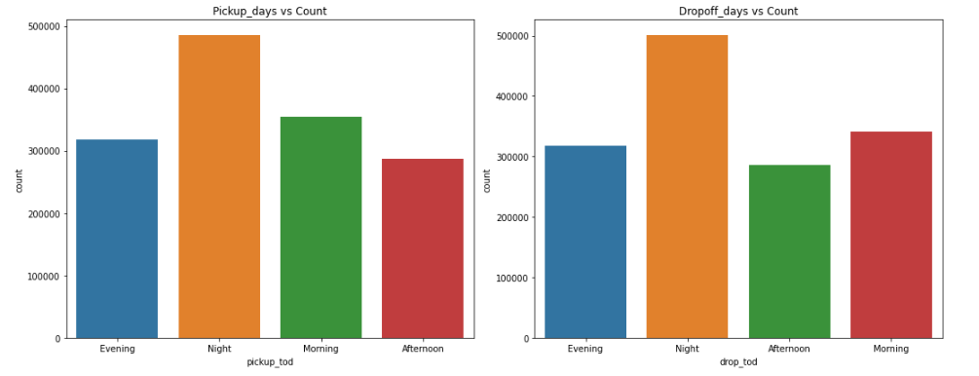
Pickup and Drop count based on time of the day

Slide 11
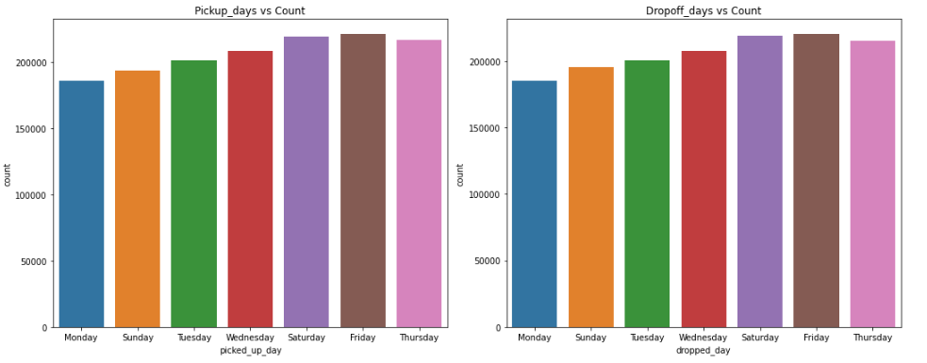
Pickup and Drop day wise countplot

Slide 12
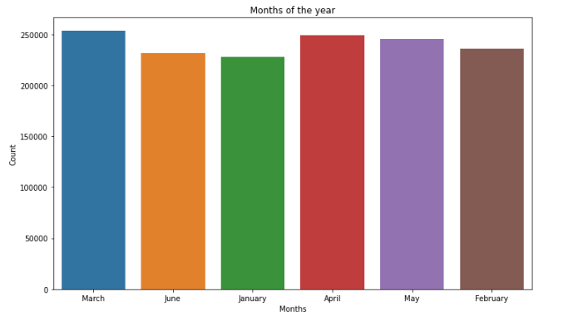
Countplot for months

Slide 13
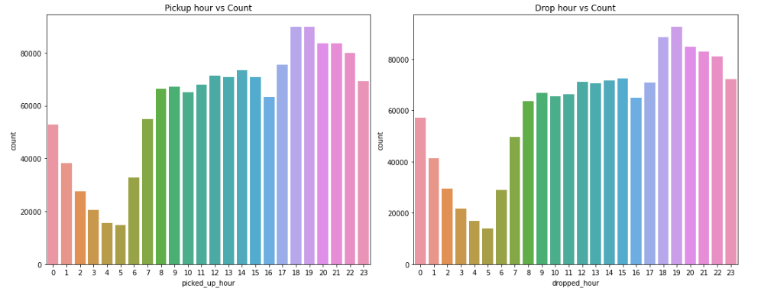
Pickup and Drop by hour

Slide 14
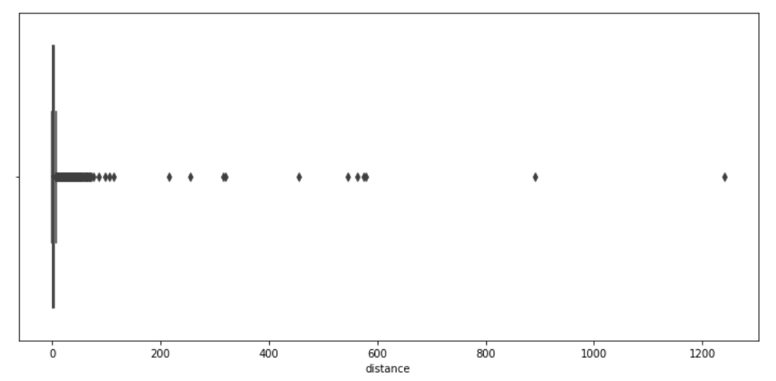
Distance countplot

Slide 15
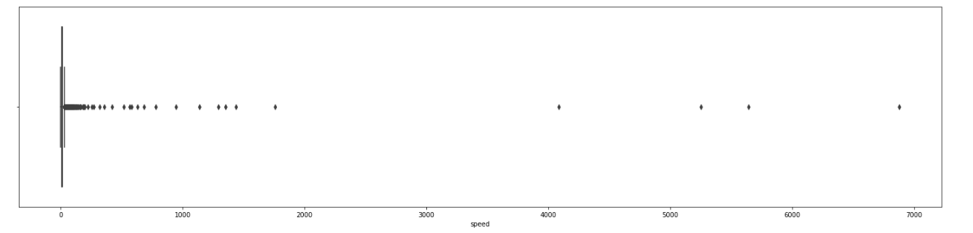
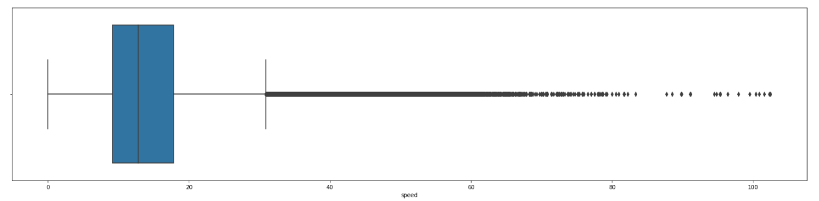
Speed before outlier removal
Speed after outlier removal

Slide 16
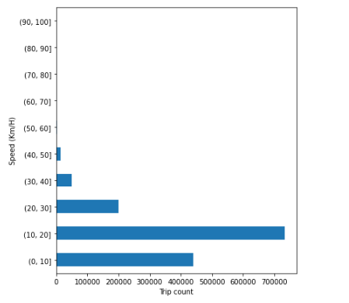
Trip count grouped by 10 km/hr

Slide 17
Bivariate Analysis

Slide 18
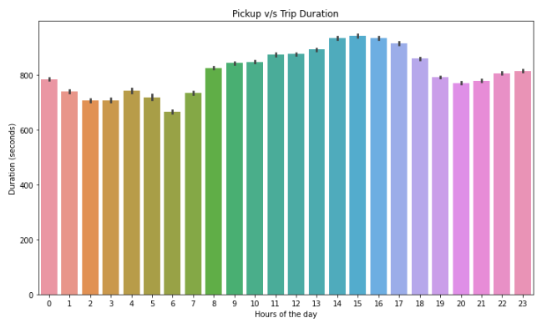
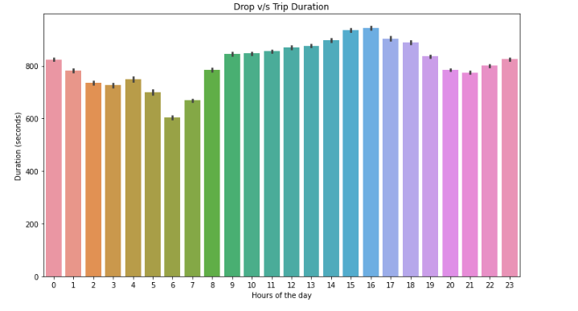
Trip Duration Per Hour

Slide 19
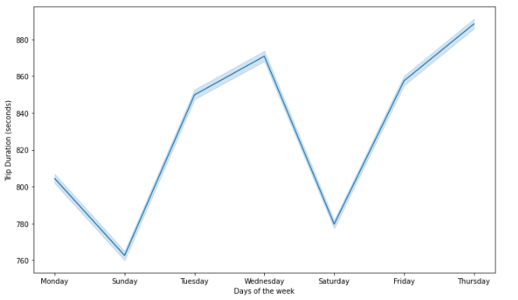
Trip Duration v/s Days of the Week

Slide 20
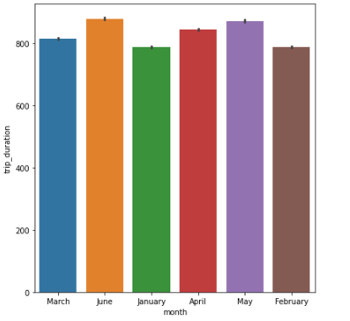
Trip Duration v/s Month

Slide 21
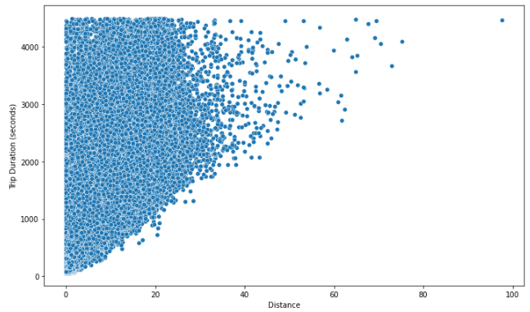
Trip Duration v/s Distance

Slide 22
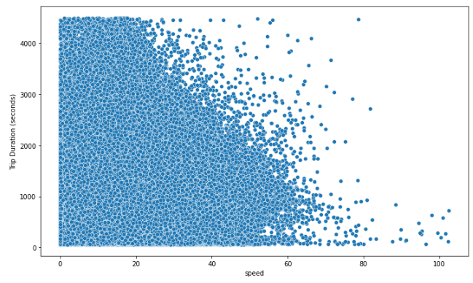
Trip Duration v/s Speed

Slide 23
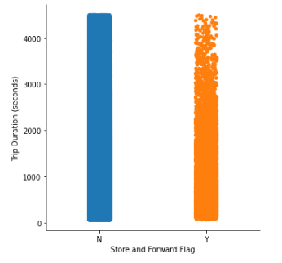
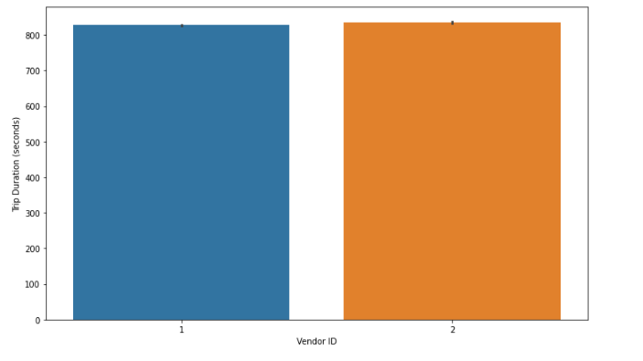
Trip Duration v/s Store and Forward Flag
Trip Duration v/s Vendor ID

Slide 24
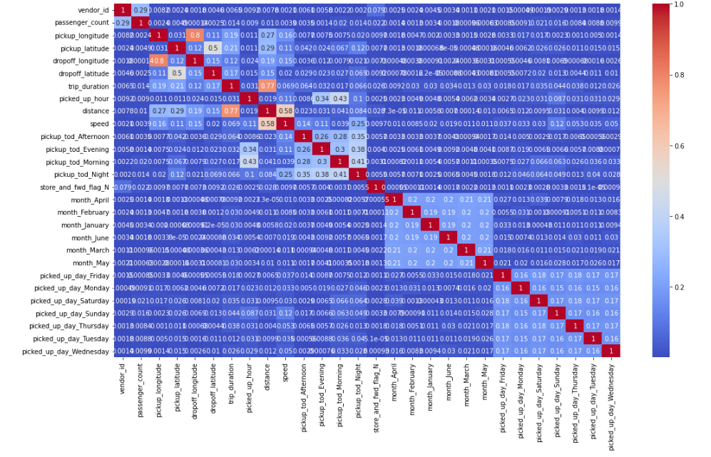
Heatmap for correlation

Slide 25
Model Implementation and Validation

Slide 26
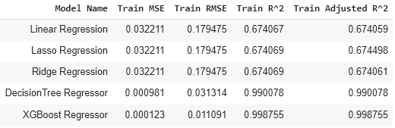
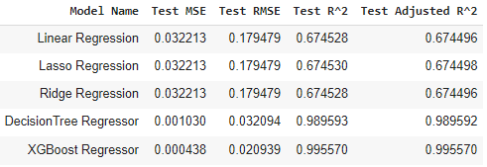
Model Validation and Selection (Regression)
Train Data
Test Data

Slide 27
Model Validation and Selection (Regression)
Observation 1:
Linear, Lasso and Ridge regression have the same r^2 score of 67.4% which is not bad.
Observation 2:
Decision Tree is good when compared to linear and almost same as XGB Regressor also it has a higher RMSE than that of XGB Regressor.
Observation 3:
XGB Regressor is the best model when compared to the above models.

Slide 28
Best Hyperparameters of XGB and Decision Tree Regressor
XGB Regressor
Decision Tree Regressor
'n_estimators' : 200 'max_depth' : 8
'min_samples_' : 40
'learning_rate': 0.2
'max_depth' : [10]
'min_samples_split' : [10]
'min_samples_leaf' : [22]

Slide 29
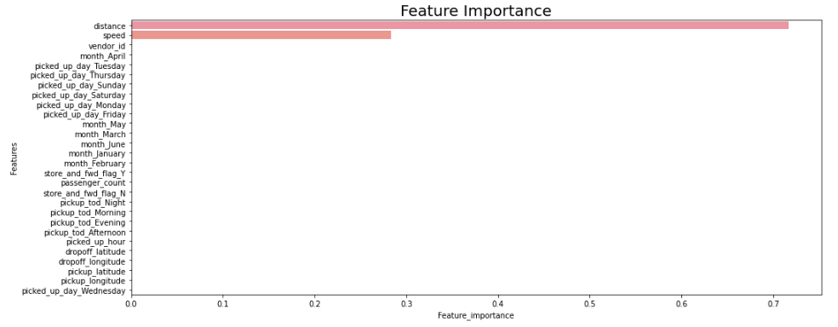
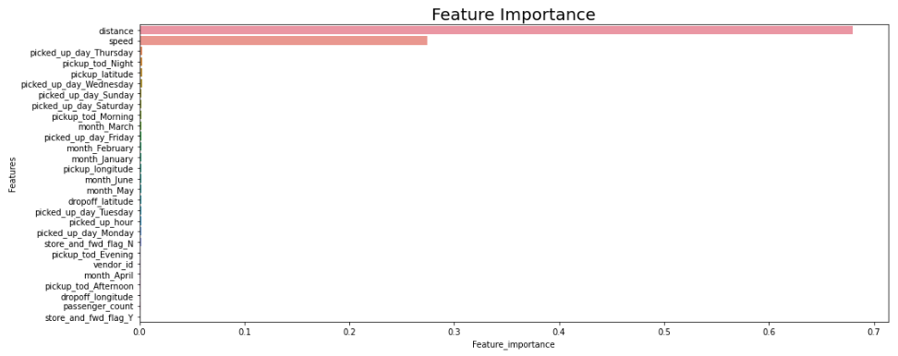
Feature Importance
Decision Tree Regressor
XGB Regressor

Slide 30
Challenges
Huge dataset.
Visualization.
Computation Time.

Slide 31
CONCLUSION
Most of the trips duration were 10 to 30 mins and were reached under 10-20 km/h with single passenger.
Evenings and late night are the busiest.
The best model for taxi time prediction is XGB Regressor when compared other implemented models.
The model can still be optimized either by doing a better EDA or implementing models or even both.
Deep Learning can still help improvise the overall evaluation metric.

